Slide 1
Pantry Chef
Tyler Gilbert, Ashton Hall, Jacob Lehtola, Braxton Wilson

Slide 2
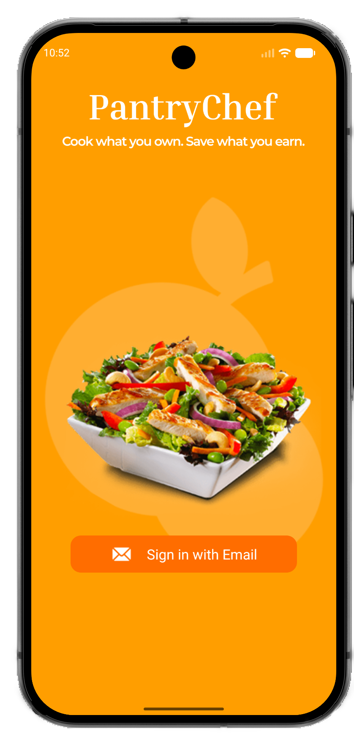
Pantry Chef, purpose
Pantry Chef is a mobile app that simplifies the process of choosing what to cook and how to cook it.

Slide 3
Pantry Chef Features
The app is organized into four main areas:
Barcode scanner
Pantry viewer
Recipe browser
Account settings

Slide 4
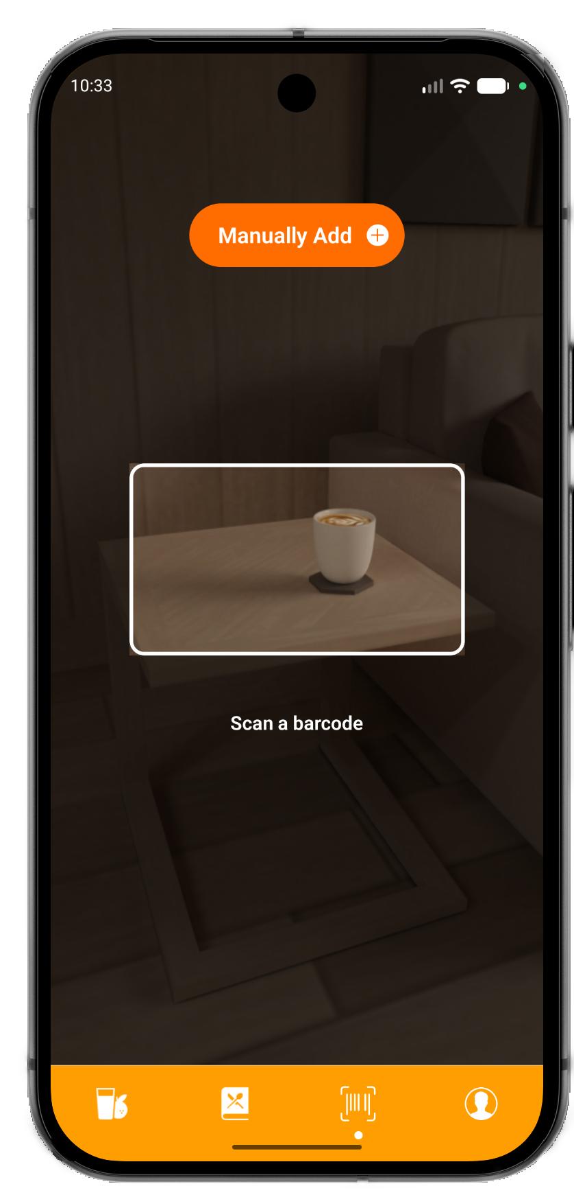
Barcode scanner
Features:
Supports adding ingredients via UPC
Support manually adding ingredients

Slide 5
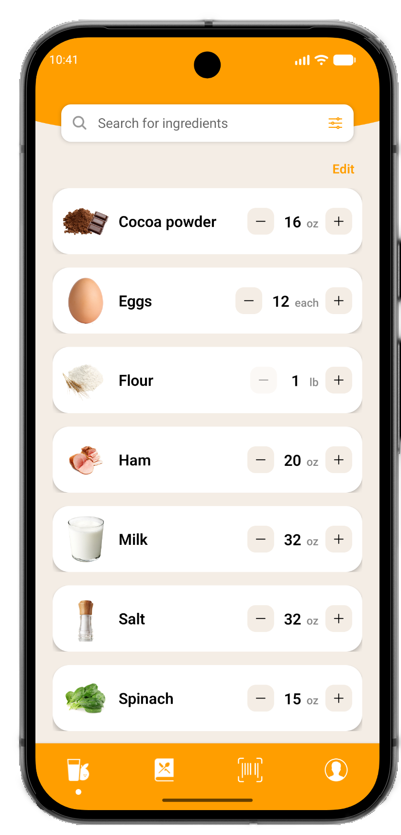
Pantry
Features:
Added ingredients show up here
Users can add, subtract, or edit ingredients
Users can search with optional filters

Slide 6
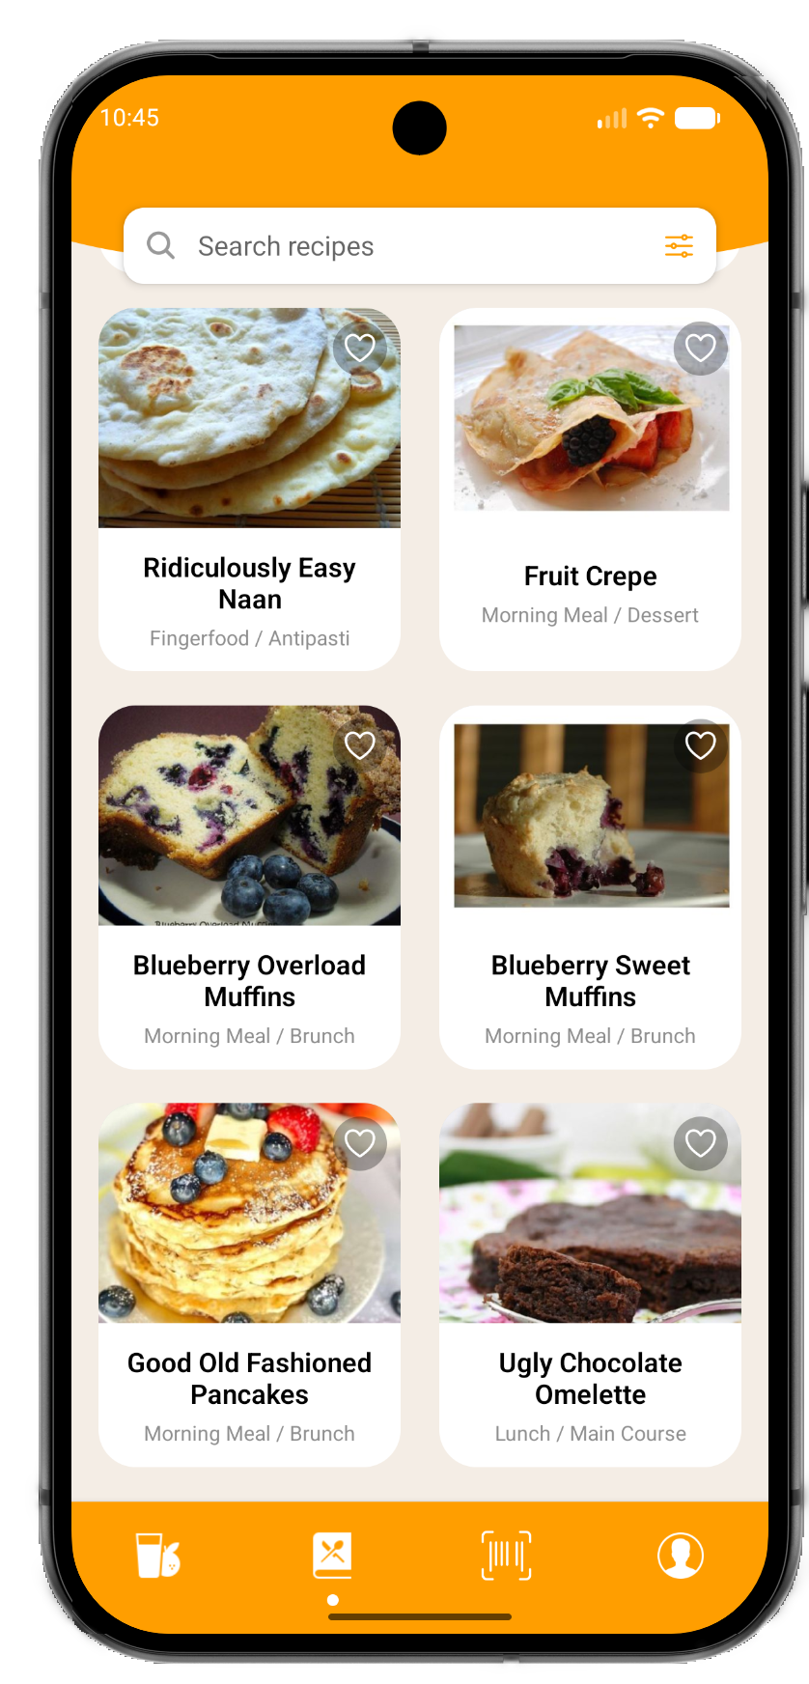
Recipe browser
Features:
Displays recipes that can be made using only present ingredients.
Includes the option to filter and search.

Slide 7
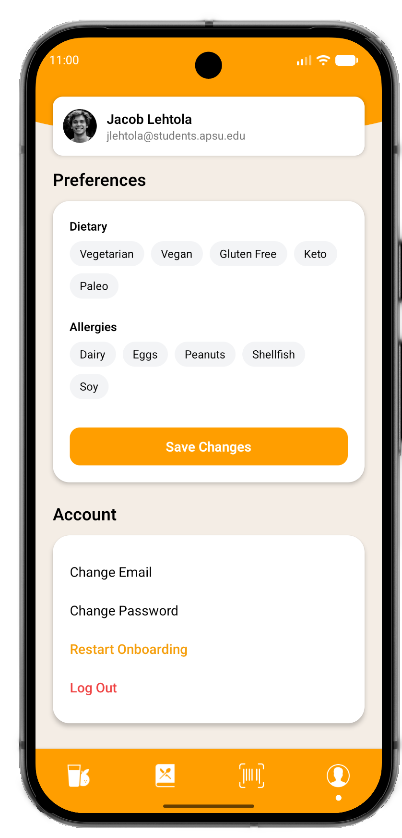
Account settings
Features:
Supports changing dietary preferences and allergies.
Allows users to manage their account.

Slide 8




Technology Used
React Native
Supabase
Spoonacular API
Visual Studio Code

Slide 9
Known Issues
The Apple version has some performance issues such as barcode scanner not working properly and not displaying ingredients and recipes.
Barcode scanner can be a little bit too sensitive.
Password reset doesn’t work.
client side API access (insecure).

Slide 10
Future Ideas
Support for dietary restrictions and allergies so that recipes and ingredients update accordingly.
A shopping list feature to support adding missing ingredients from chosen recipes.
An AI vision feature to support bulk adding ingredients from a pantry photo.
Potential smart fridge integration.

Slide 11
Let’s get cooking!

Slide 12


Pantry Chef
Thank you!

